Slide 1
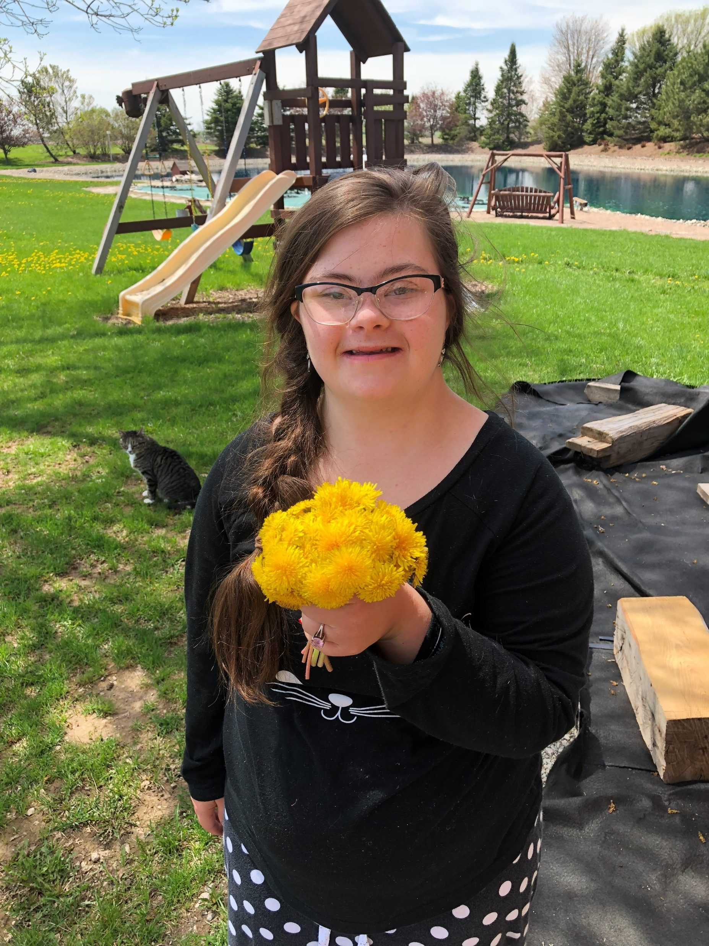

Slide 2



Slide 3
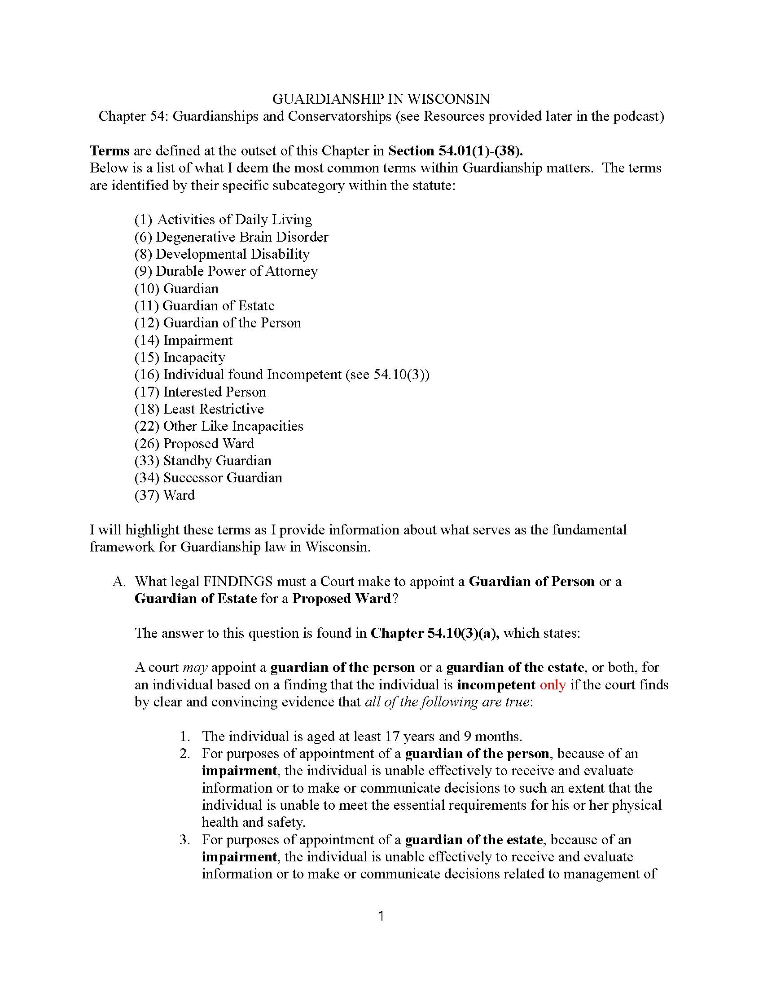

Slide 4
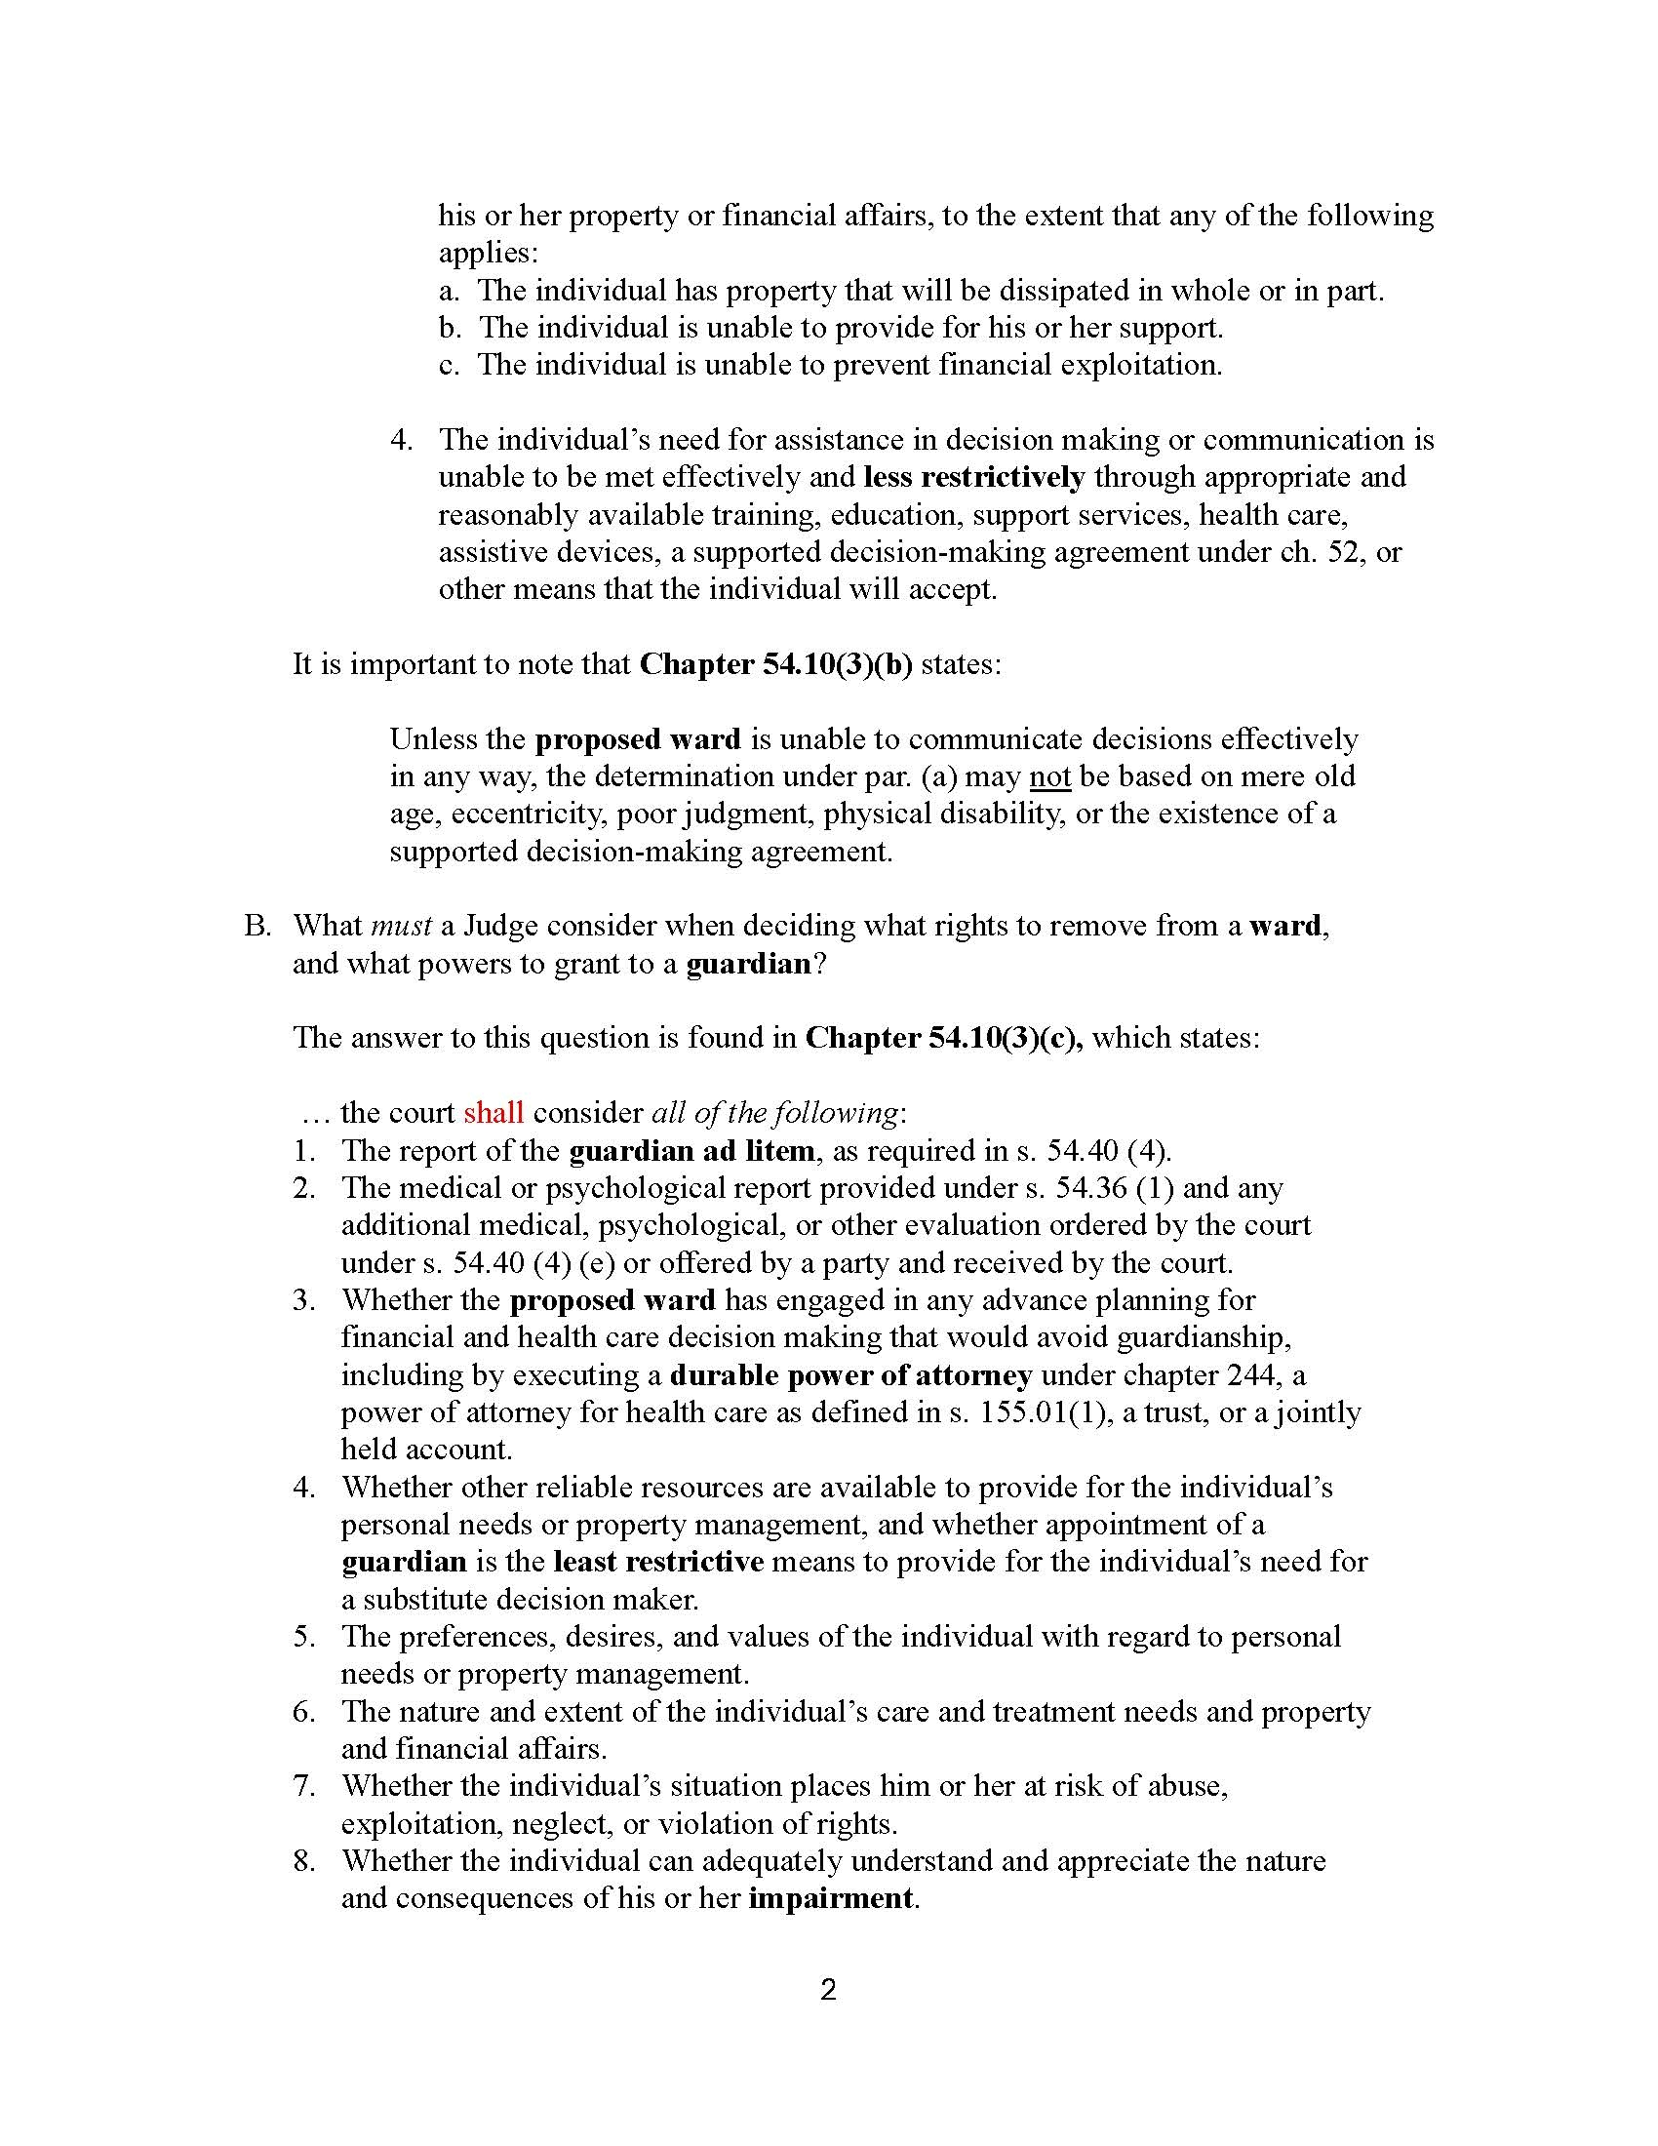

Slide 5
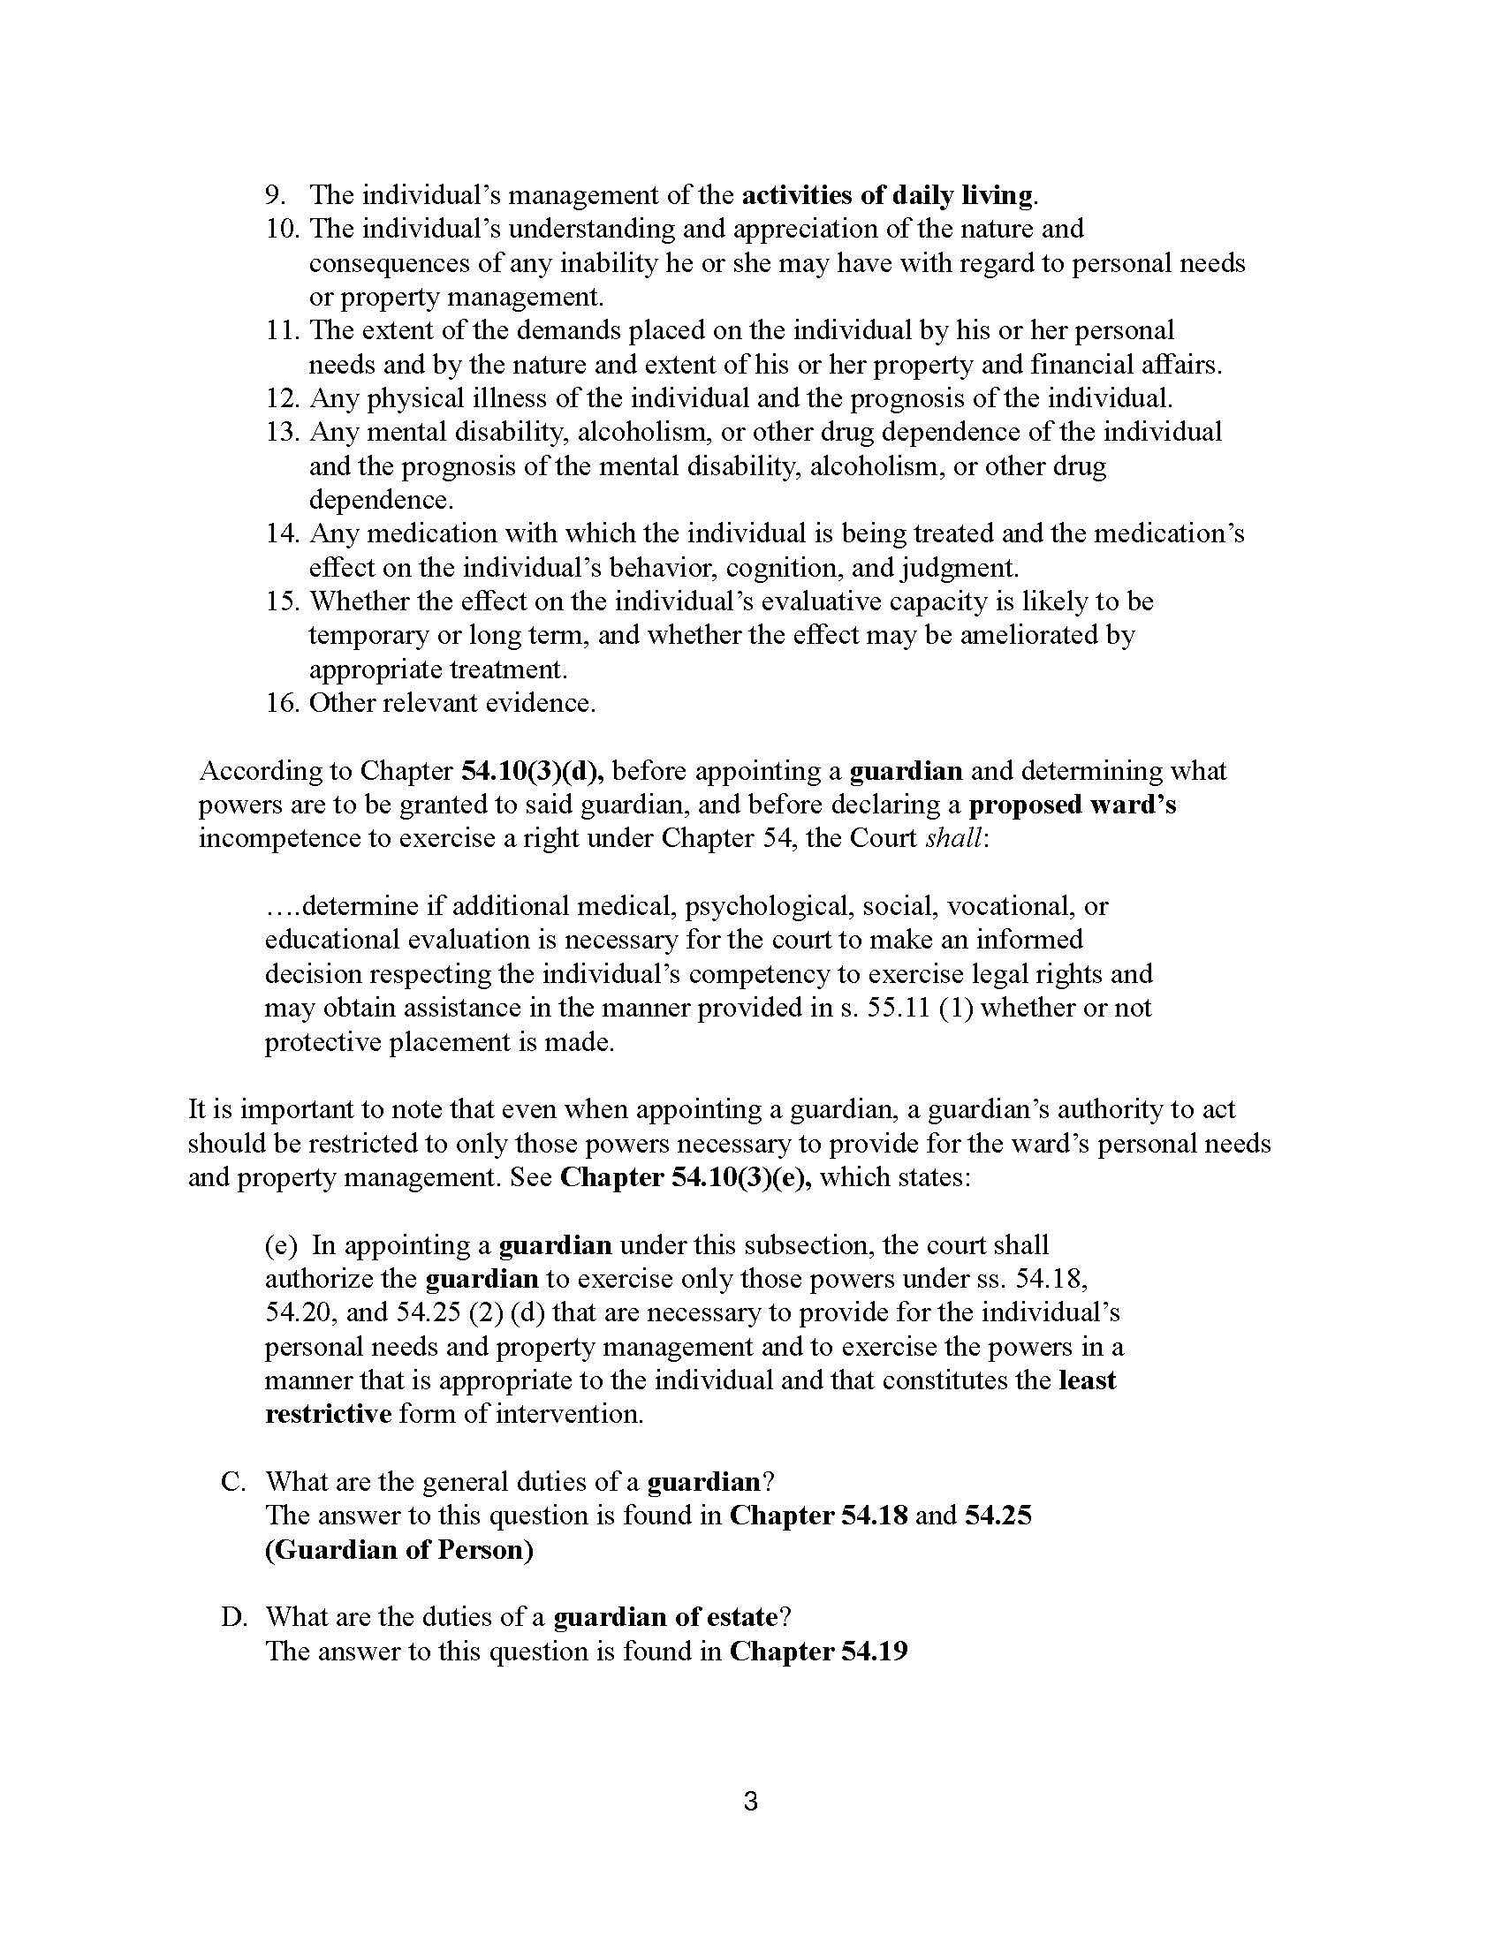

Slide 6
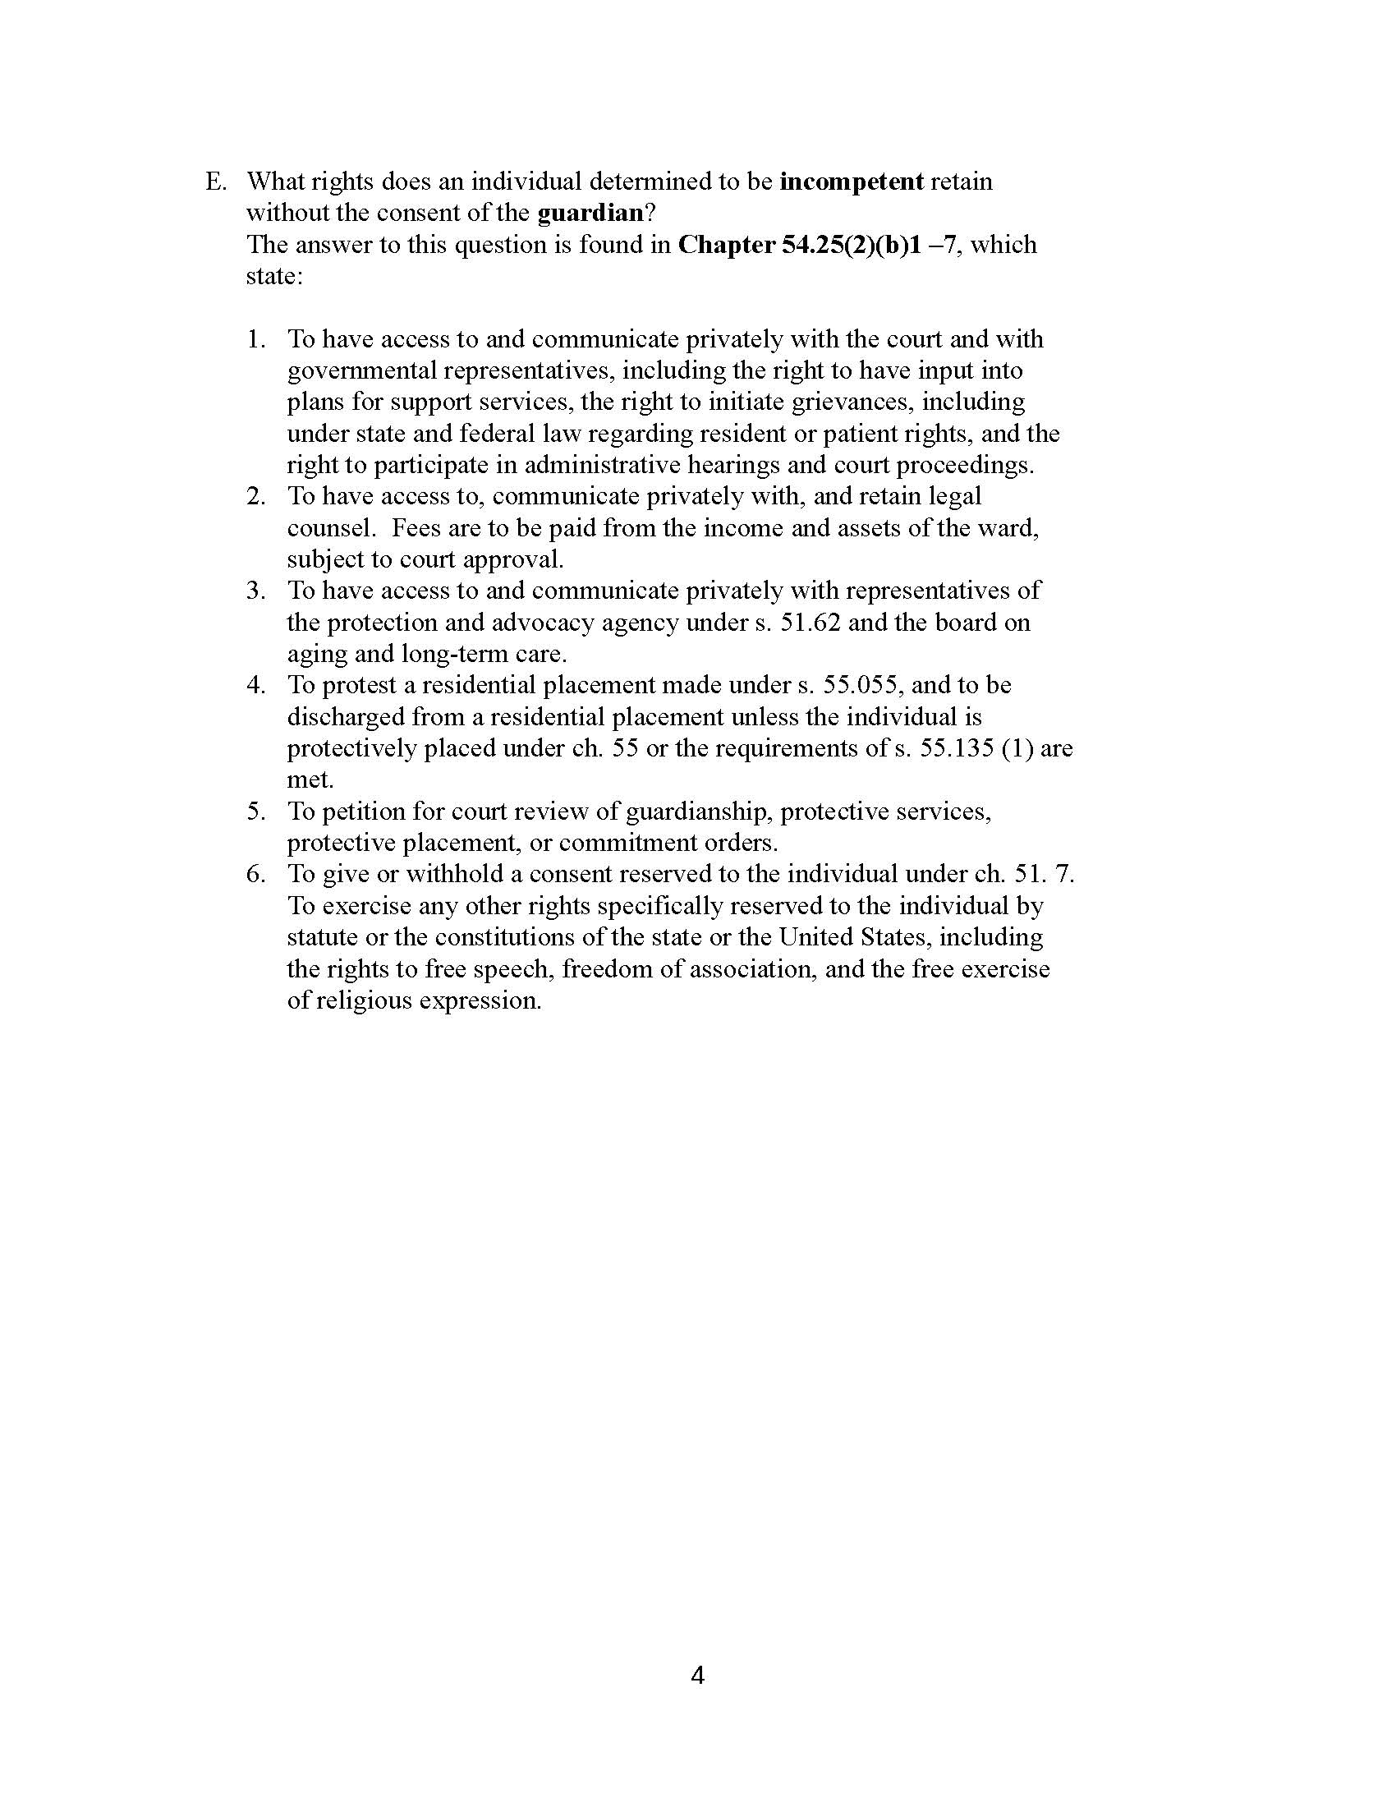

Slide 7
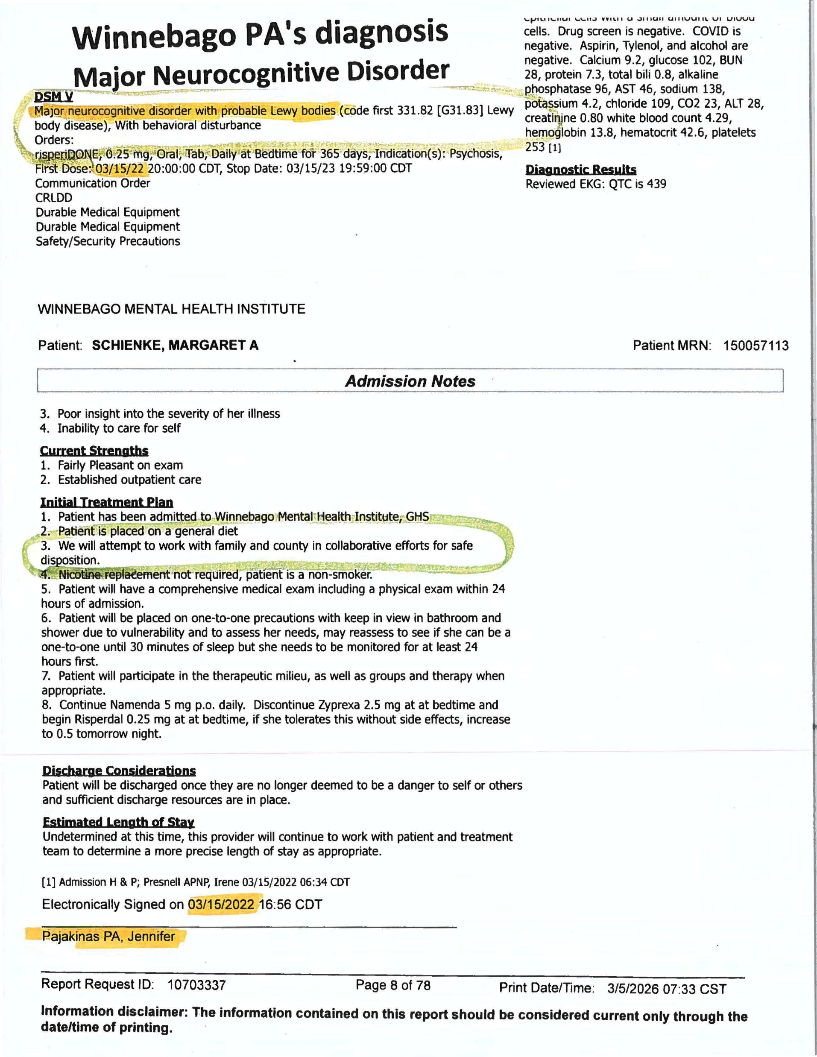

Slide 8
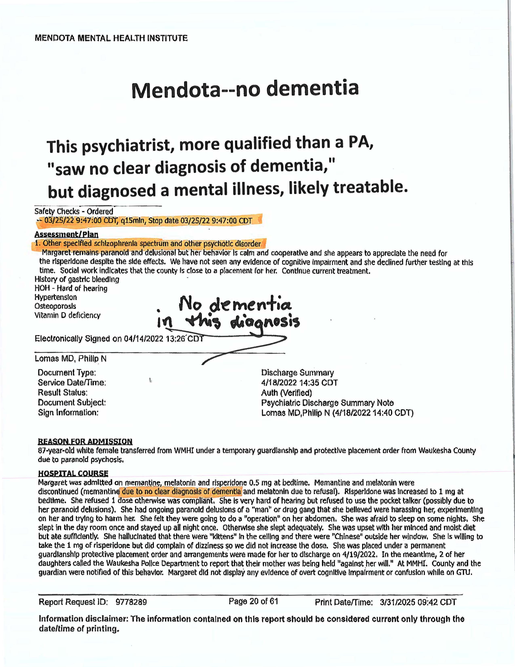

Slide 9
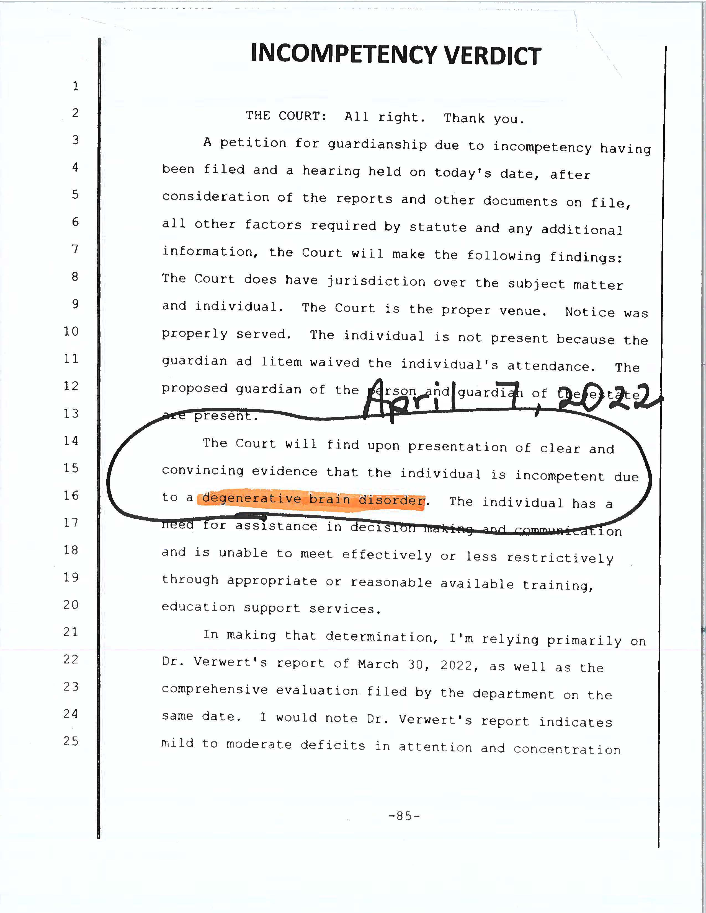

Slide 10
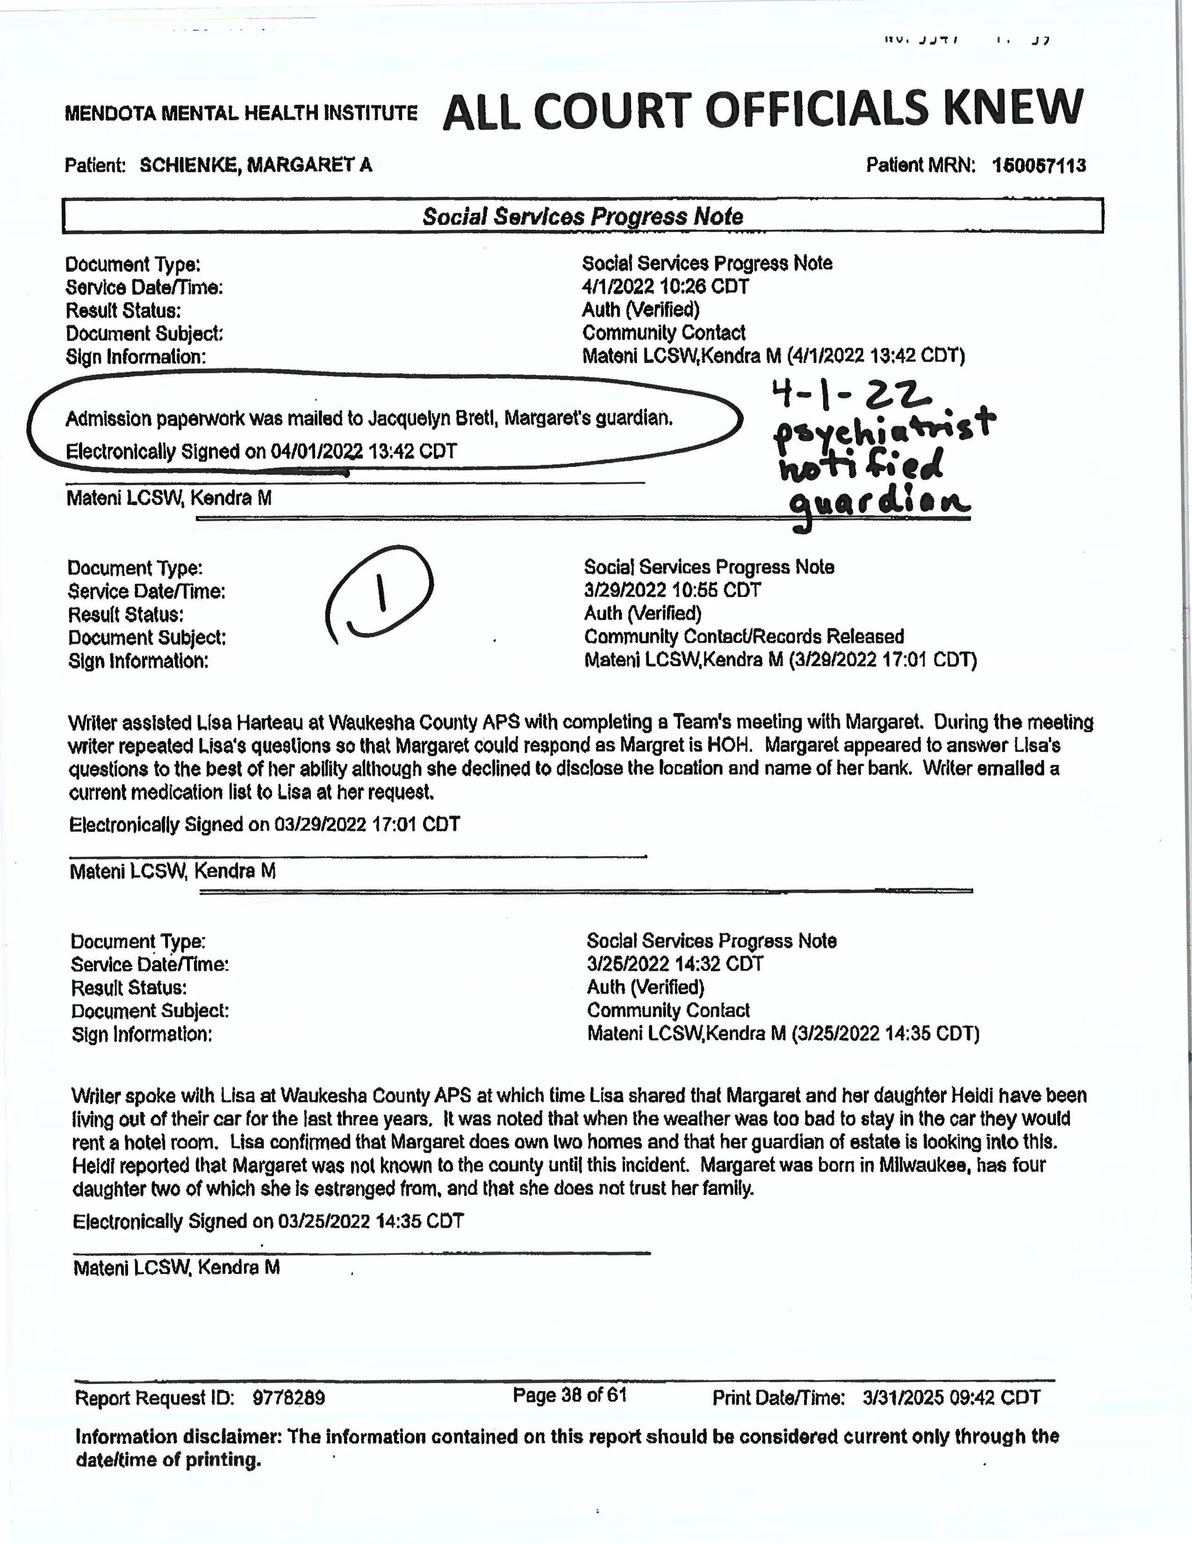

Slide 11
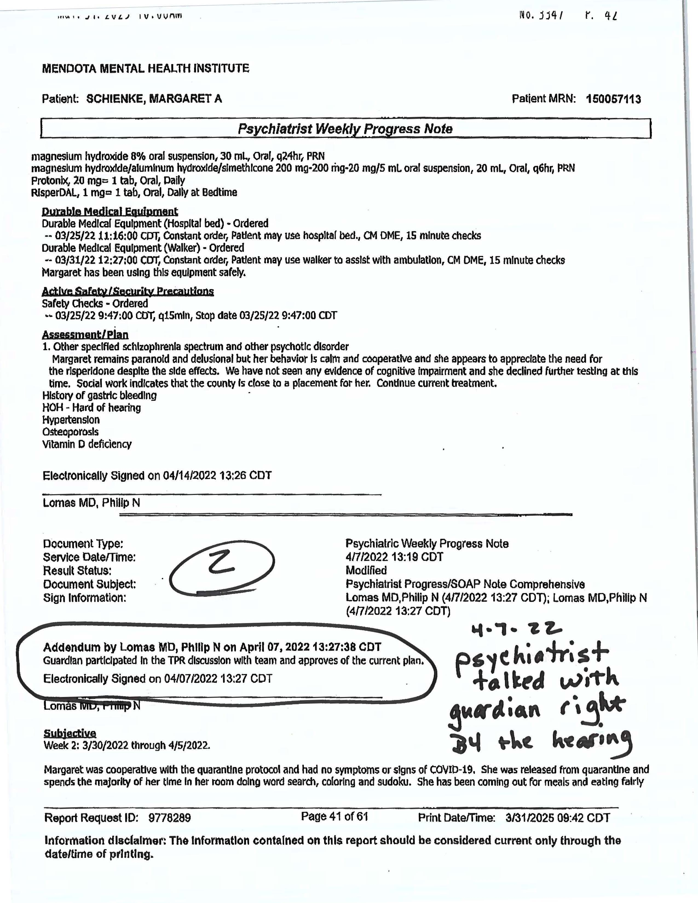

Slide 12
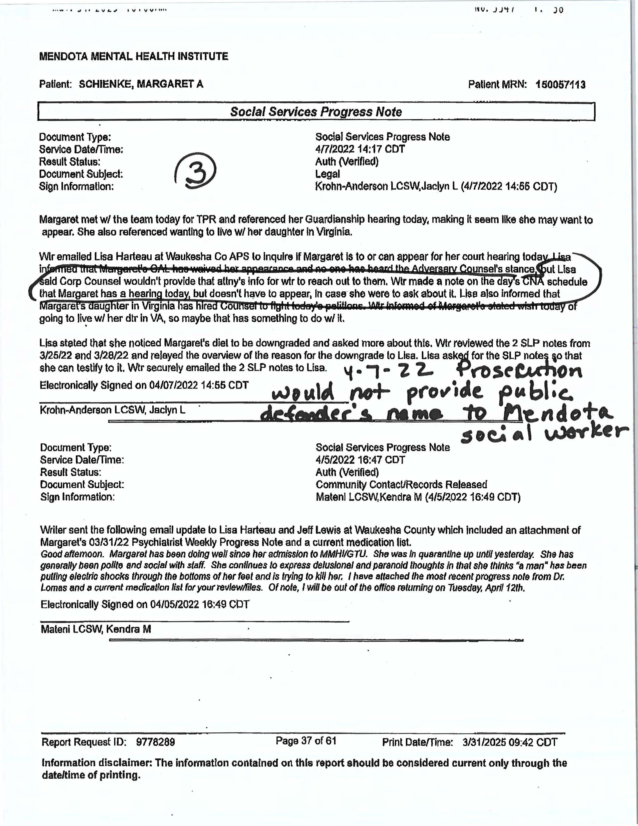

Slide 13
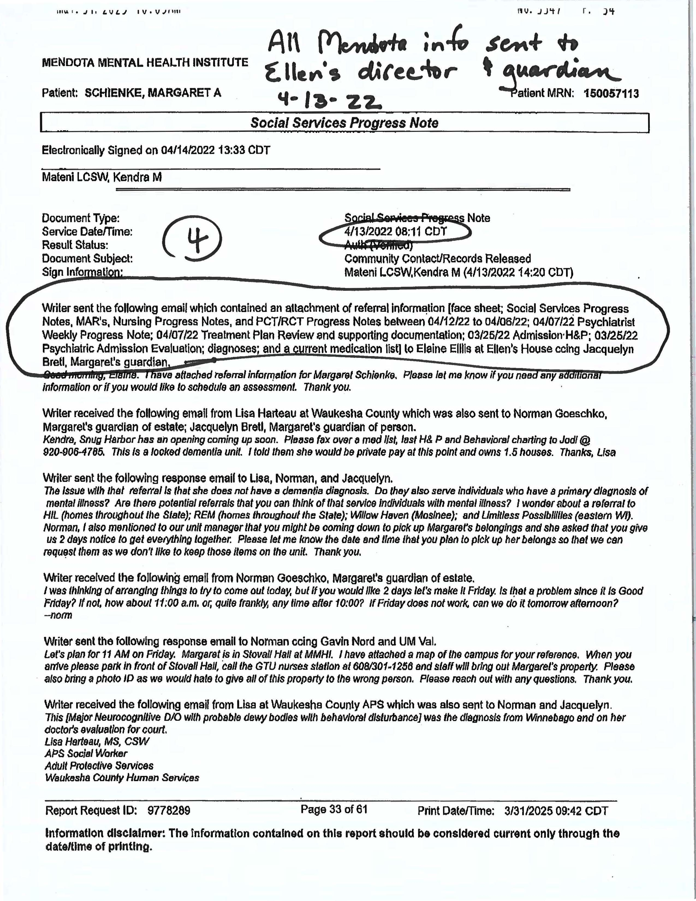

Slide 14
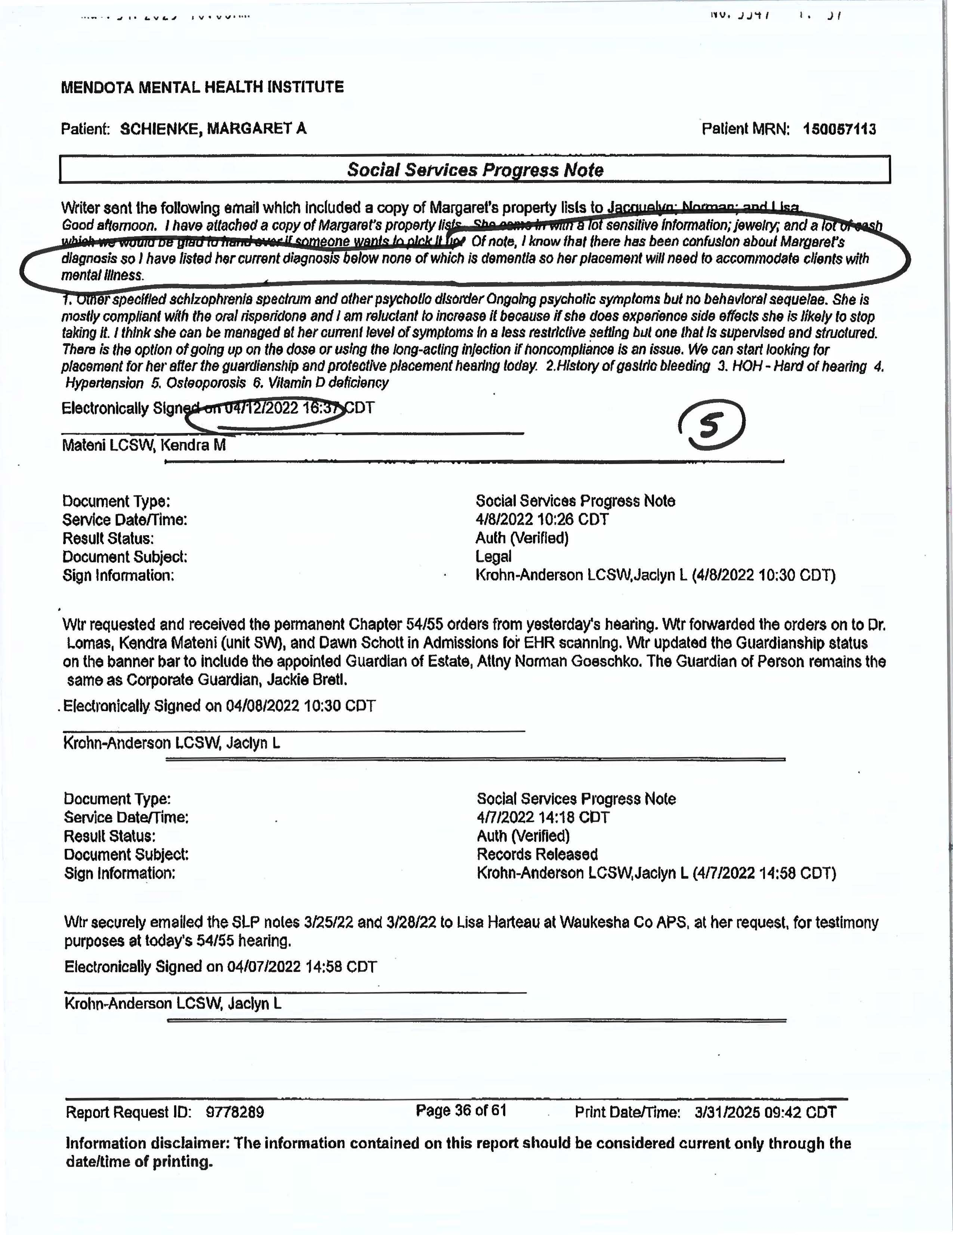

Slide 15
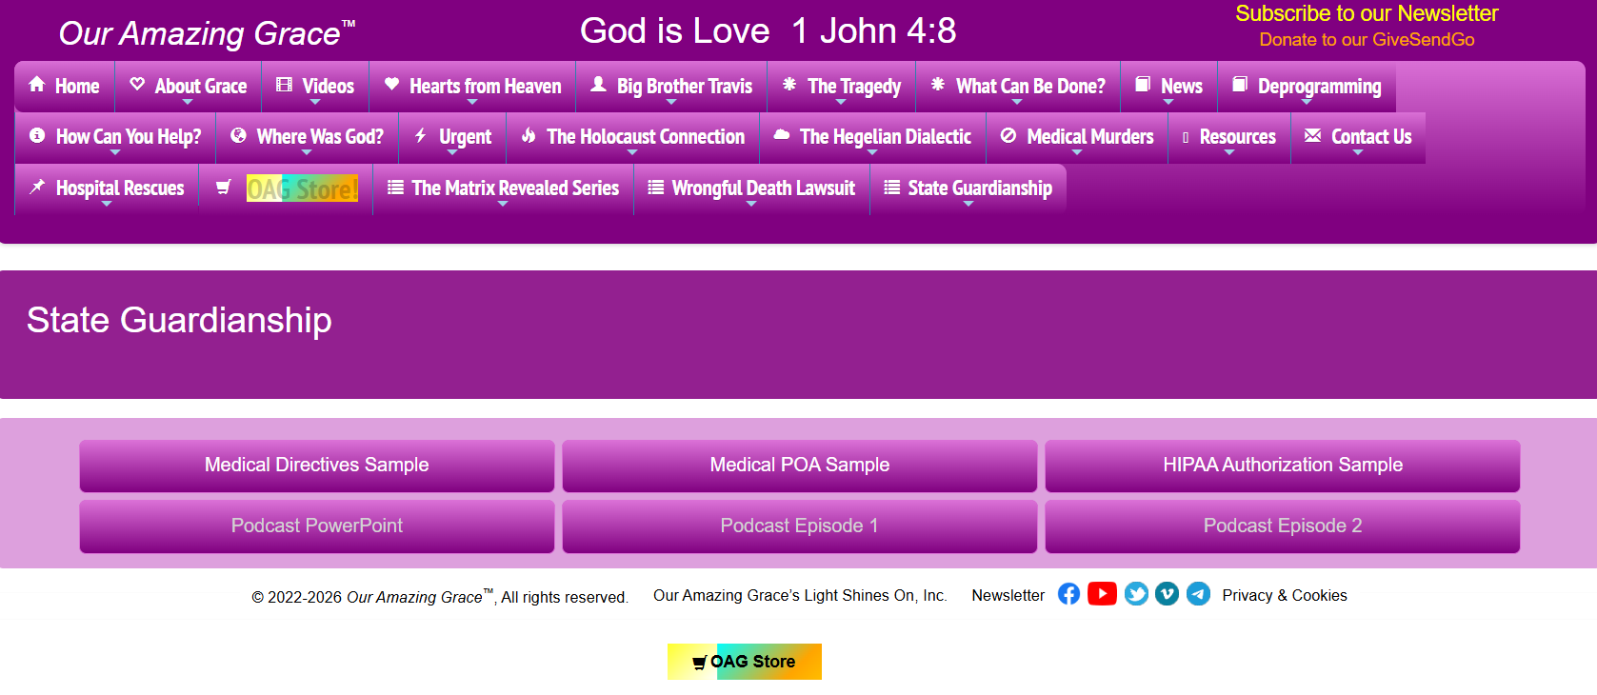

Slide 16
Resources
Wisconsin Guardianship Training:
Guardianship Training - UW-Green Bay
Wisconsin Guardianship Statutes:
https://docs.legis.wisconsin.gov/statutes/statutes/54
Wisconsin Protective Placement Statutes:
https://docs.legis.wisconsin.gov/statutes/statutes/55
Wisconsin Law Library Resources:
https://wilawlibrary.gov/topics/familylaw/guardian.php
Rights of the Ward in Guardianship cases in Wisconsin:
https://gwaar.org/api/cms/viewFile/id/2004348
Wisconsin Guardianship Forms:
https://www.wicourts.gov/forms1/circuit/formcategory.jsp?Category=17
Guardianship Resources:
https://gwaar.org/guardianship-resources
https://www.wifamilyconnectionscenter.org/families-caregivers/guardianship-information-resources/guardianship-information-resources-2/
https://www.dhs.wisconsin.gov/clientrights/guardianship.htm

